Slide 1
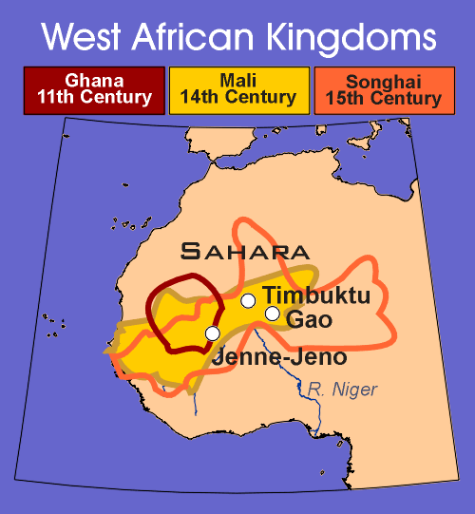
Kingdoms of West Africa

Slide 2
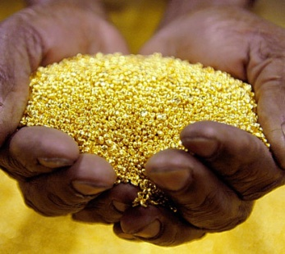
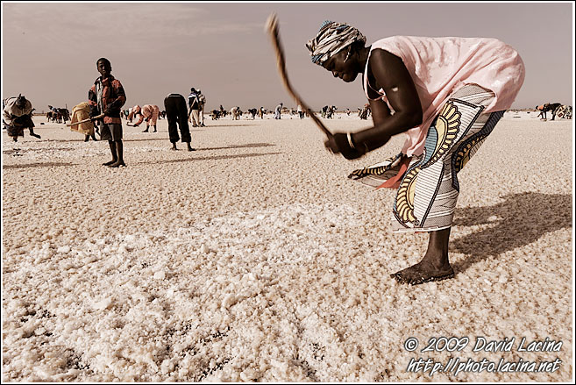
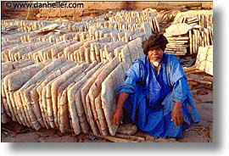
Trade in the Sahara:
A.D 100 – Agriculture villages expanded
Farming led to surplus – more than needed
Commodity – valuable product
Traded for leather goods, kola nuts, cotton cloth, slaves, silk, metal, beads, horses, gold & salt,
Gold & salt most important
SALT – more valuable than gold
Must have salt to live (humans and animals) – hot, tropical areas – lose salt to perspiration
Also used to preserve food
Chopping salt in a salt flat
Blocks of salt to be sold – some houses were built of salt!

Slide 3
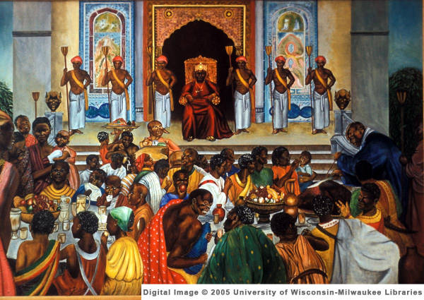
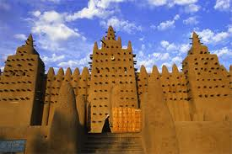
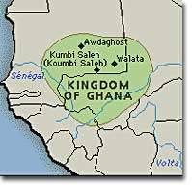
Ghana – Land of Gold
Islam first came to N. Africa in the 600s AD – rulers embraced it
A.D 800 – Kingdom of Ghana
Controlled trade of gold & salt
Walled cities
Known for wealth & splendor
Muslim merchants brought Islamic technology, coins, language, government ideas and religion
1050 A.D. – taken over by Almoravids

Slide 4
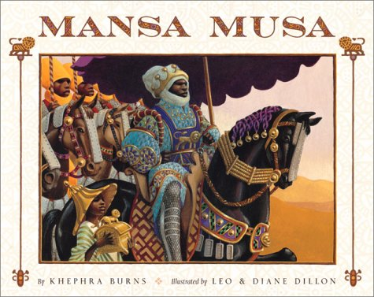
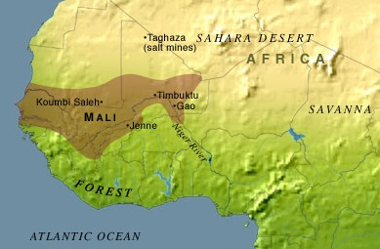
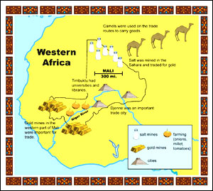
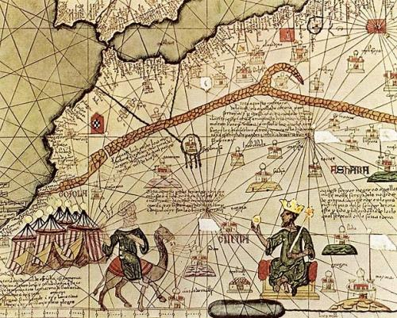
The Kingdom of Mali
Founded in 1235 A.D.
Greatest ruler = Mansa Musa – 1312
Reigned 25 years
Ensured peace, justice & prosperity
Islamic but tolerant of other religions
1324 A.D. made Hajj (pilgrimage) to Mecca
Developed ties w / other Muslim states
Promoted Islamic education

Slide 5
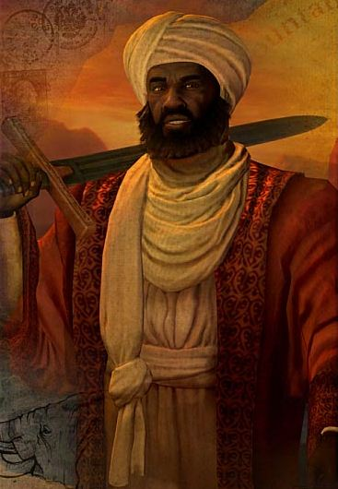
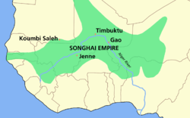
Songhai Empire – 1460s – 1591 A.D.
Largest state that ever existed in W. Africa
Professional Army
Followed traditional religious beliefs, not Islam
Eventually became Islamic kingdom
Improved government bureaucracy & officials

Slide 6
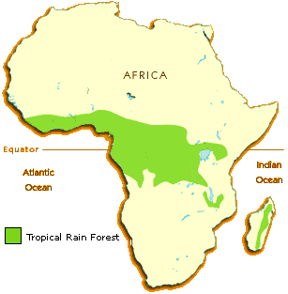
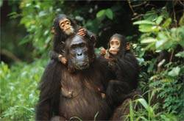
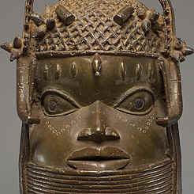
African Rain Forest
Benin
Forest Kingdom of Benin
Traded pepper, ivory, & bronze sculptures
Famous for sculpted wax technique of bronze sculpture – very detailed
By 1500s deeply involved with Portuguese & slave trade

Slide 7
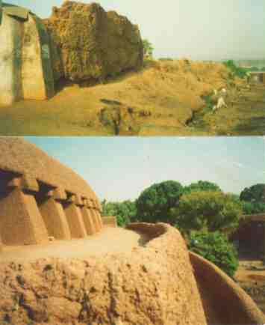
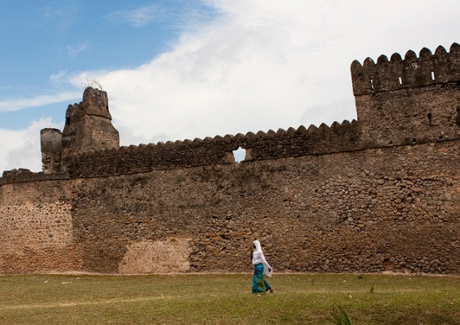
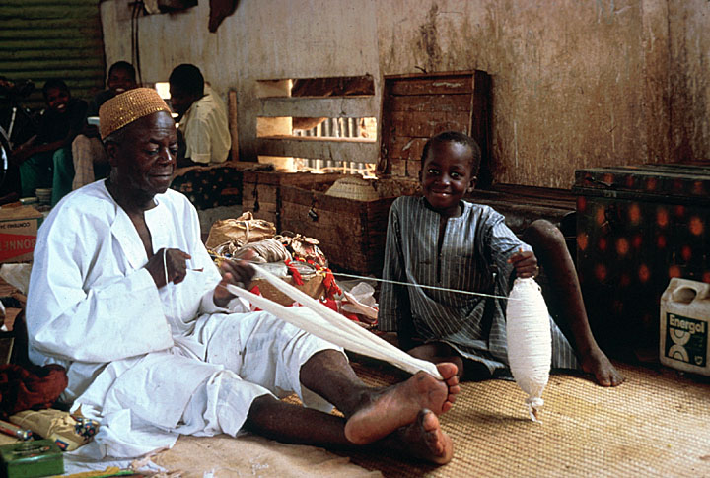
Walled City-States of Hausa
1300s – built clay-walled cities
Thriving commercial centers:
Sold goods as far away as Europe
Kano had walls over 12 miles in circumference and 50 ft high!
Population more than 30,000
Influenced by Islamic law and Arabic Script
Had many rulers who were women

